Slide 1
Regular Meeting
Mar. 3, 2023
Hyonho Chun & Gwangwoo Kim

Slide 2
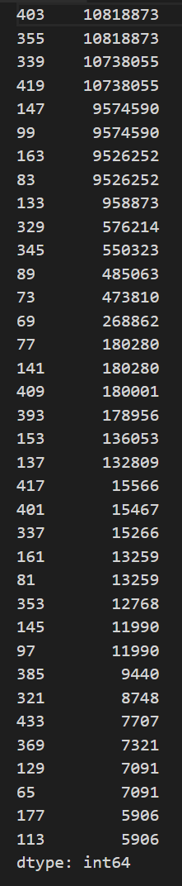
Preprocessing
Intermediate outputs of Smart-Seq are used for our work. (HISAT2PairedEnd)
Many reads are not uniquely mapped to the reference genome.

Slide 3
Preprocessing
Then, for each sample, we make a count matrix by implementing HTSeq-count
It gives a 19 by 55304 count matrix.

Slide 4
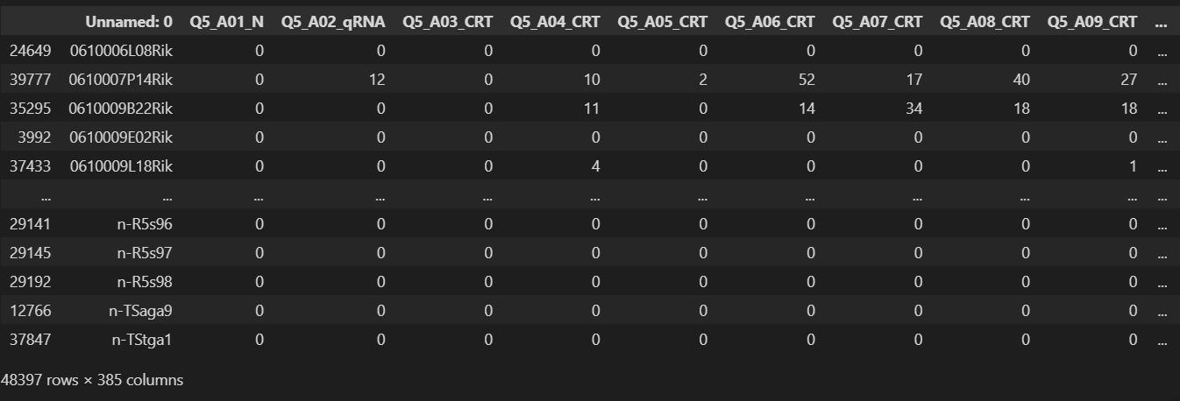
Preprocessing
GSE130312_compiled_counts_20190410.csv can be downloaded from GSE130312.

Slide 5
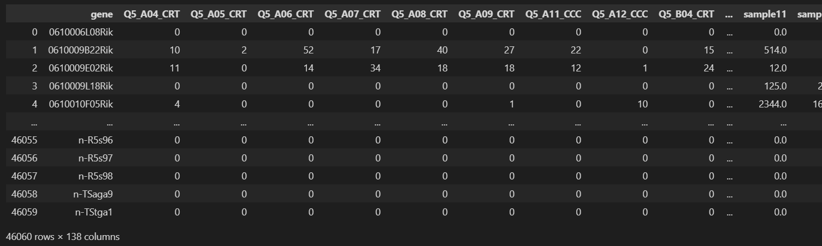
Issue
But, the number of the features (or gene) of the matrix differs from that of our matrix inferred from HTSeq-count. (48397 -><- 55304)
We extract the features that are presented in both matrices. Finally, 46060 features will be used.

Slide 6
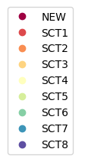
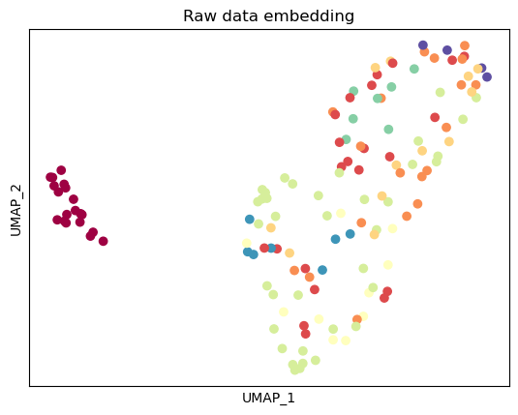
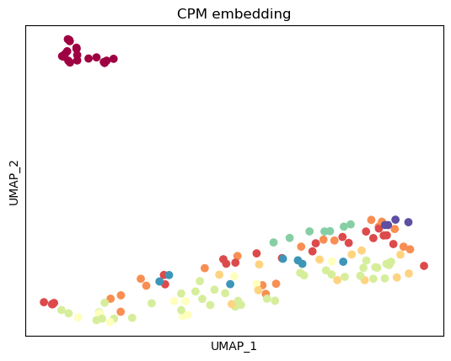
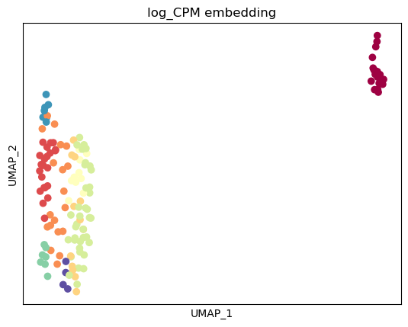
Checking samples: using lower dimensional embedding (46060->2)

Slide 7
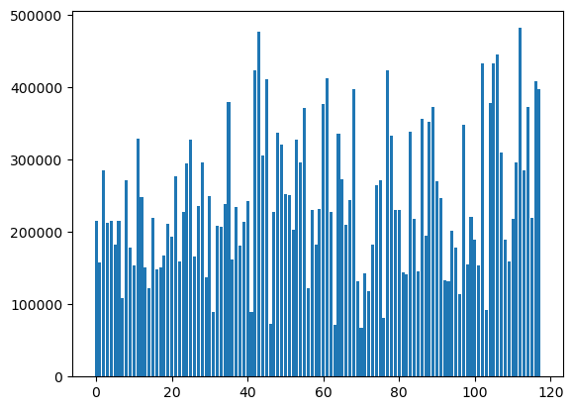
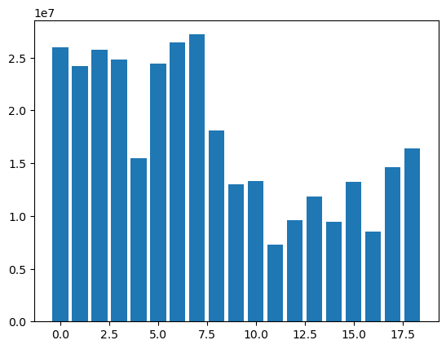
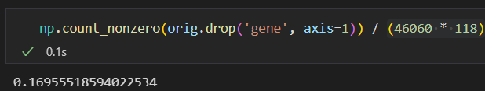
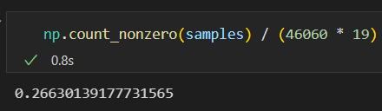
Total read counts are very different!

Slide 8
Trial and error
Gene selection (HVG)
Harmony
NeuroCombat
Combat-seq
SCGEN
Seurat 3
Rliger
scVI

Slide 9
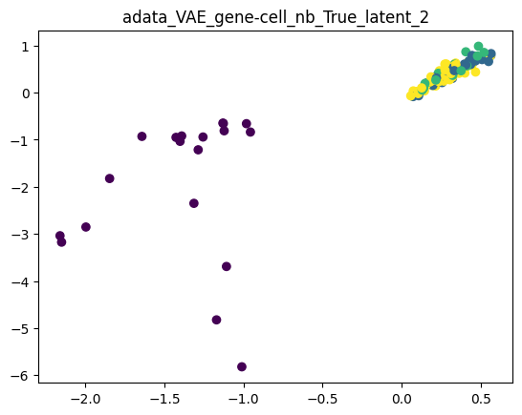
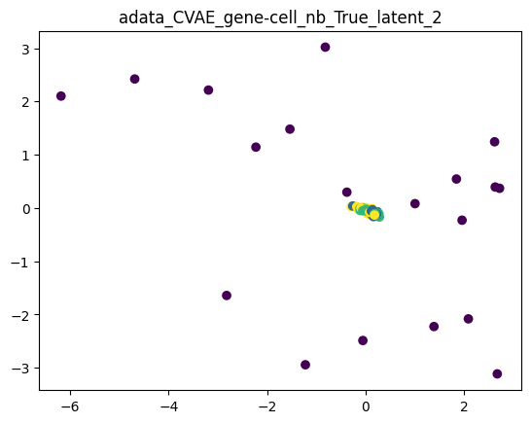
scVI
scVI is a model that can perform many analysis tasks; for example, Dimensionality reduction, removal of unwanted variation, integration across replicates, donors, and technologies, differential expression, etc.

Slide 10
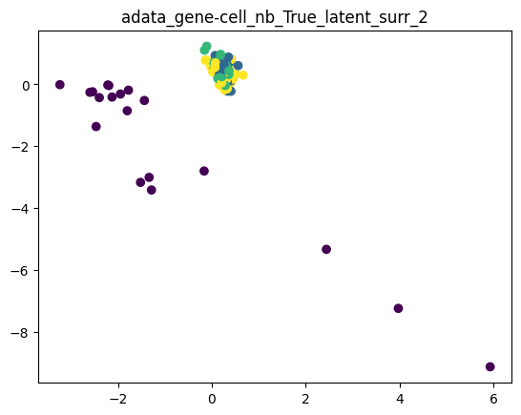
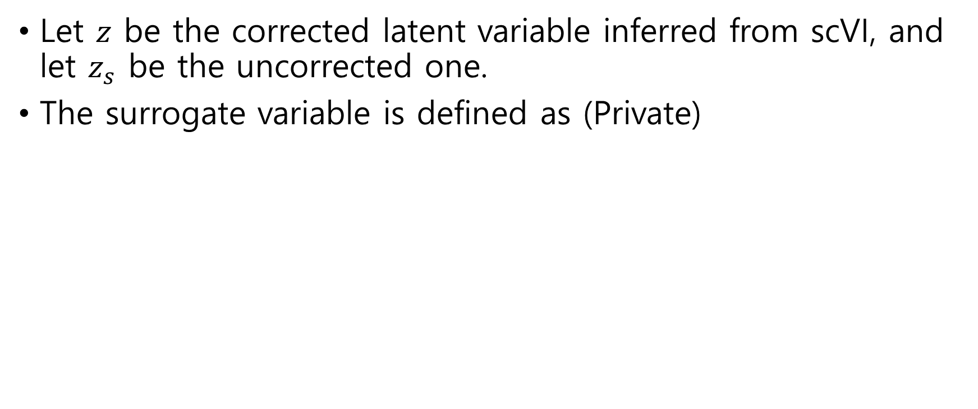
Surrogate variables are created to adjust for the study bias.
Let $z$ be the corrected latent variable inferred from scVI, and let $z_{s}$ be the uncorrected one.
The surrogate variable is defined as (Private)

Slide 11
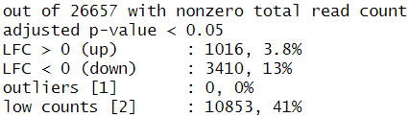
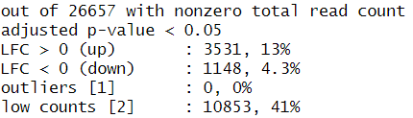
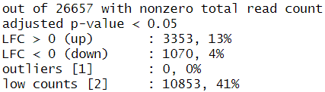
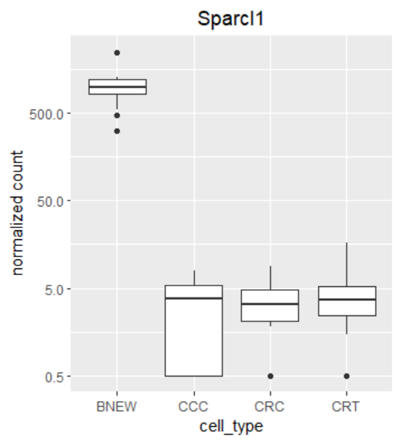
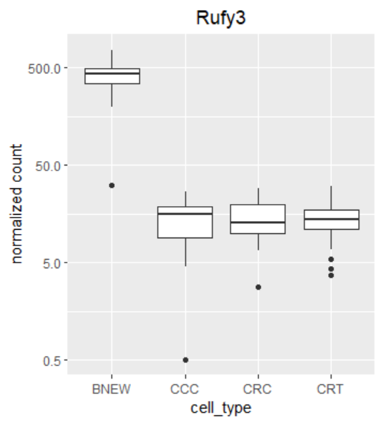
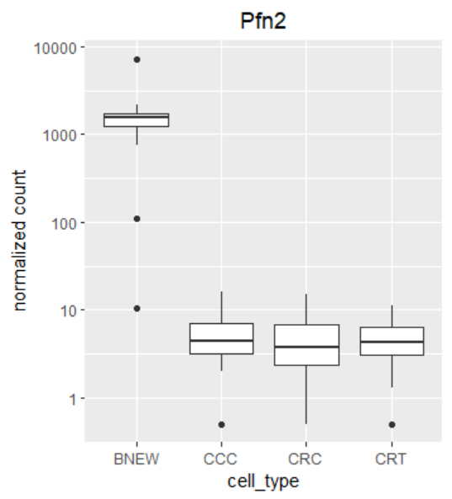
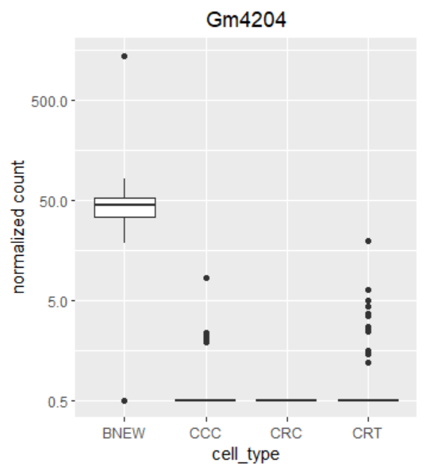
DESeq2 results
CCC vs NEW
CRT vs NEW
CRC vs NEW

Slide 12
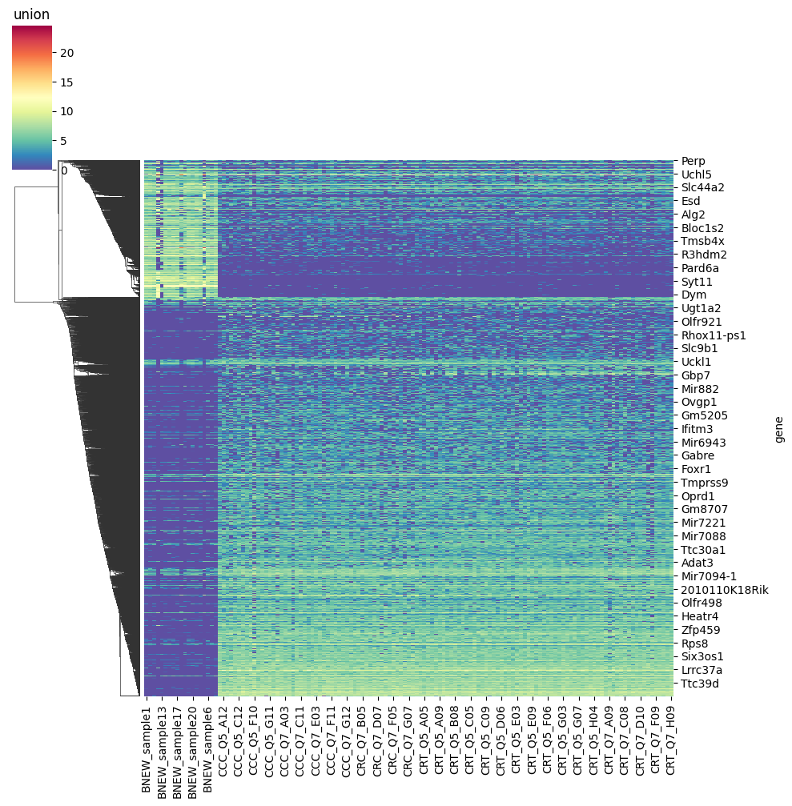
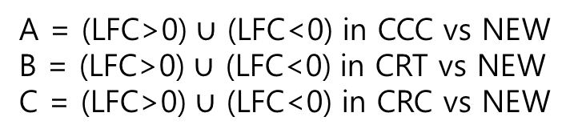
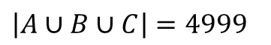
DESeq2 results
A = (LFC>0) $∪$ (LFC<0) in CCC vs NEW
B = (LFC>0) $∪$ (LFC<0) in CRT vs NEW
C = (LFC>0) $∪$ (LFC<0) in CRC vs NEW
A
B
C
$\left|A∪B∪C\right|=4999$

Slide 13
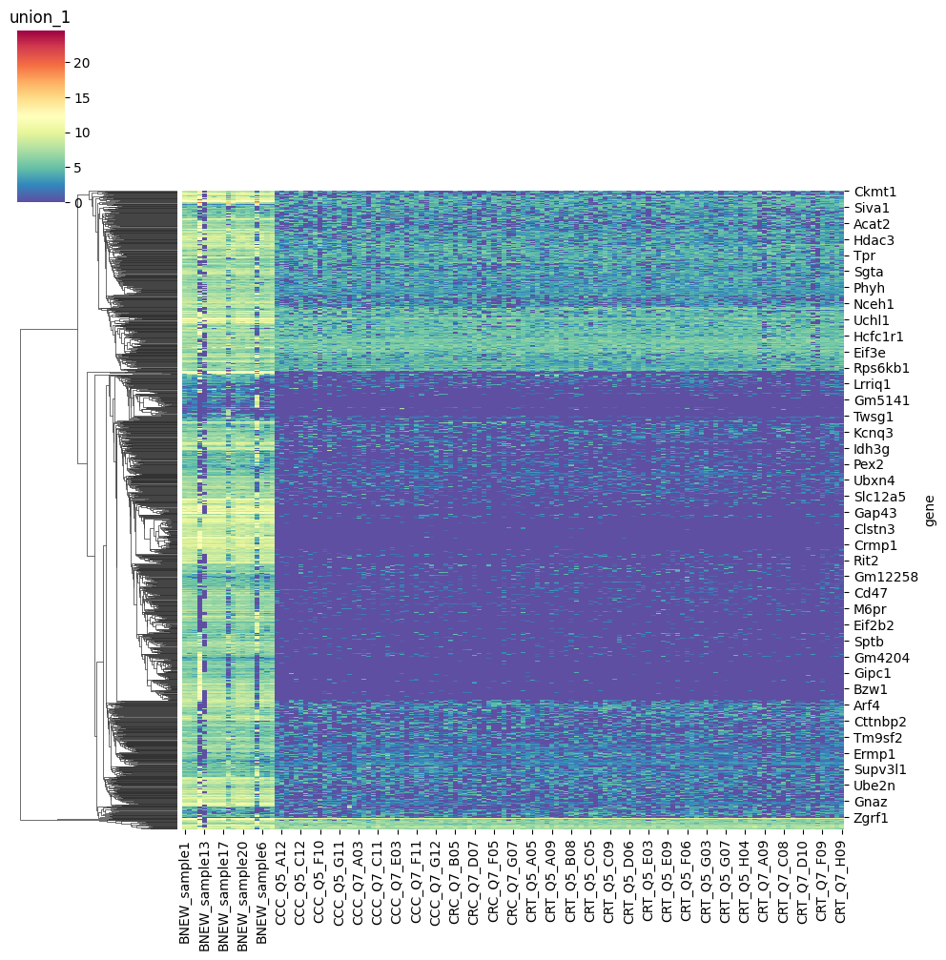
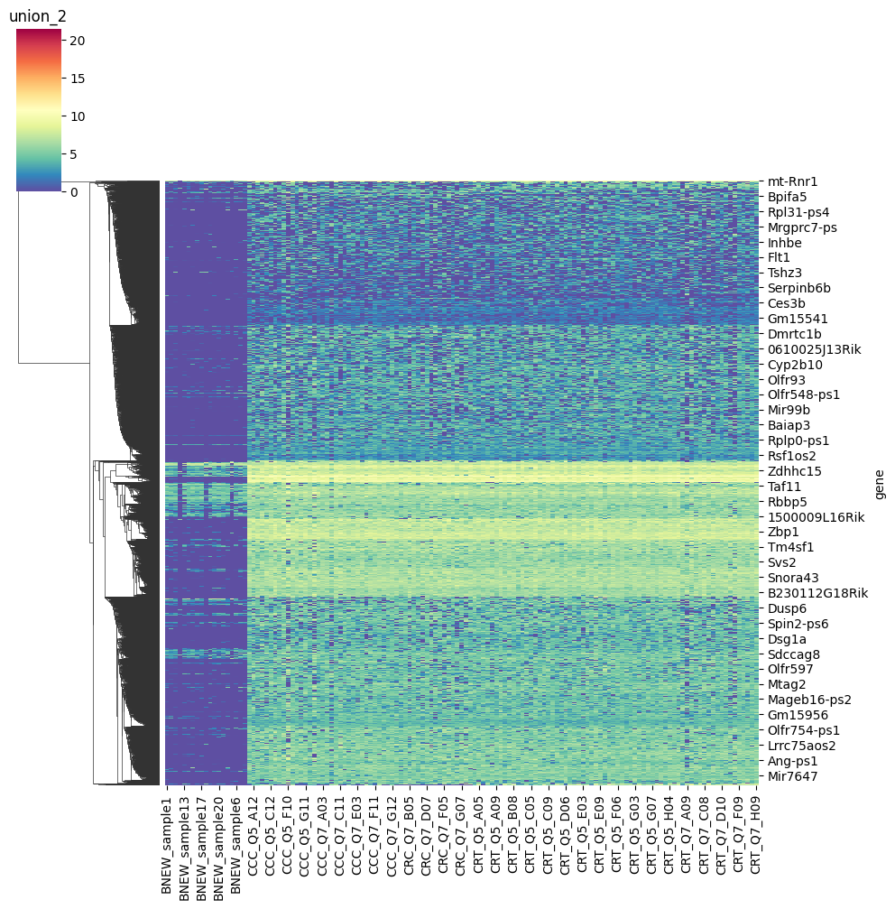

Slide 14
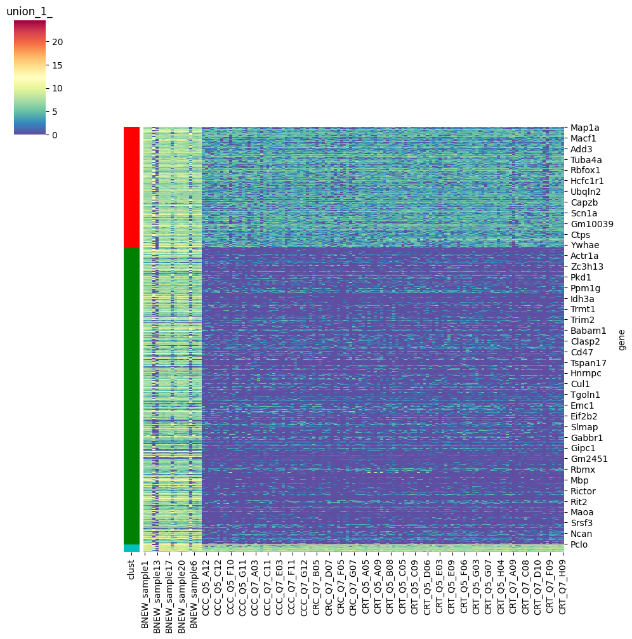

Slide 15
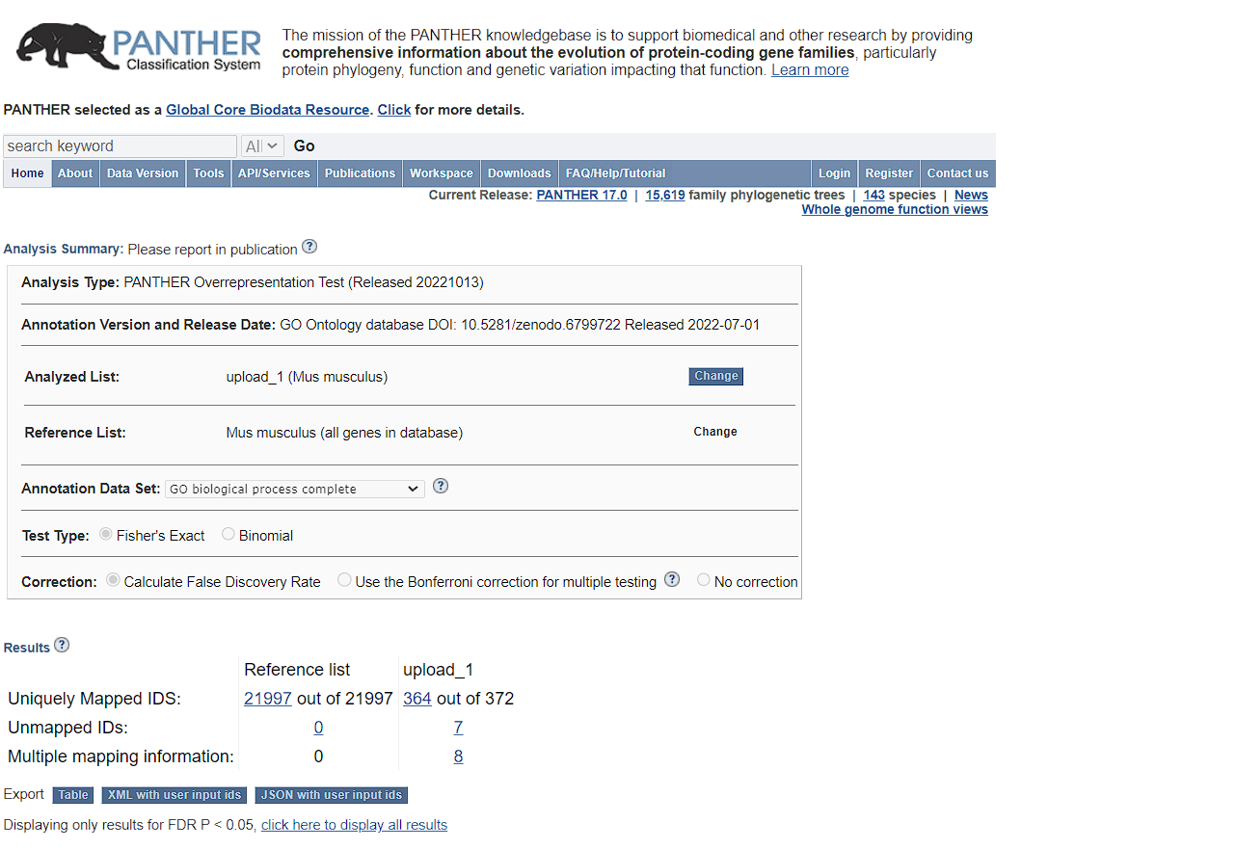
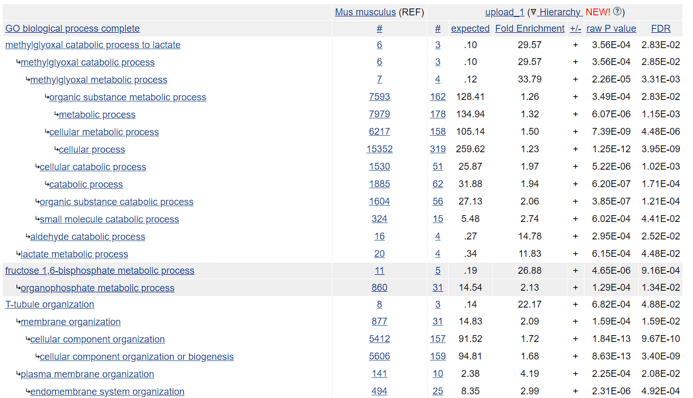

Slide 16
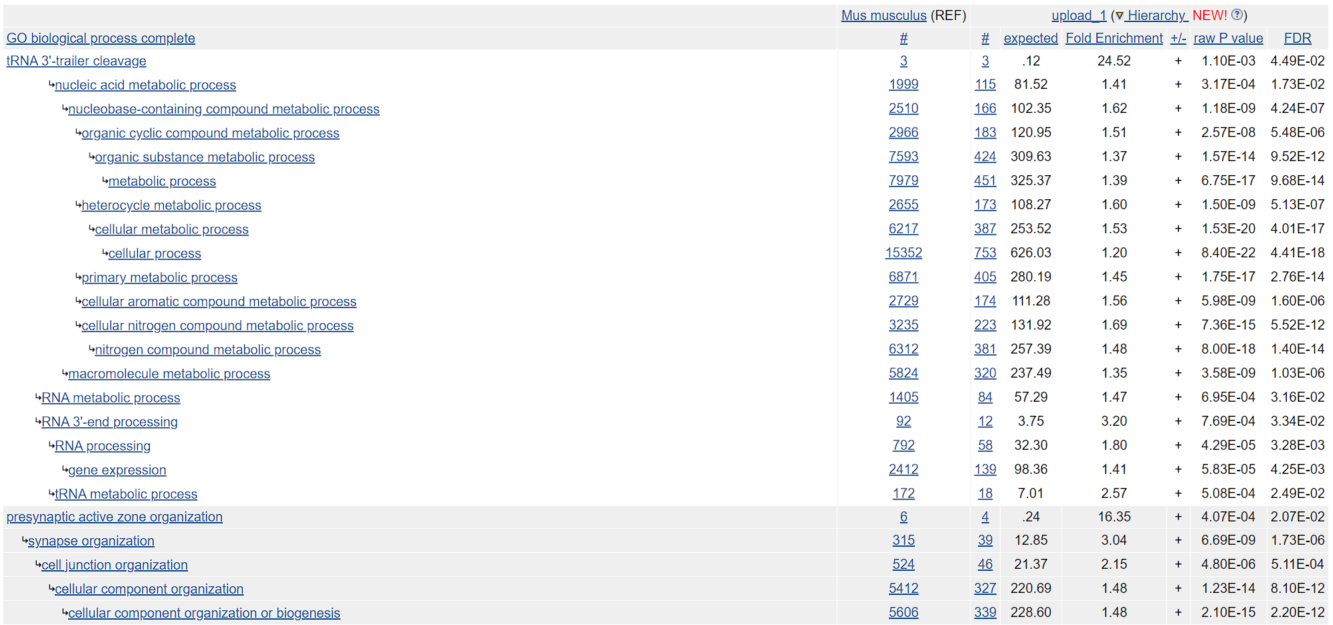

Slide 17
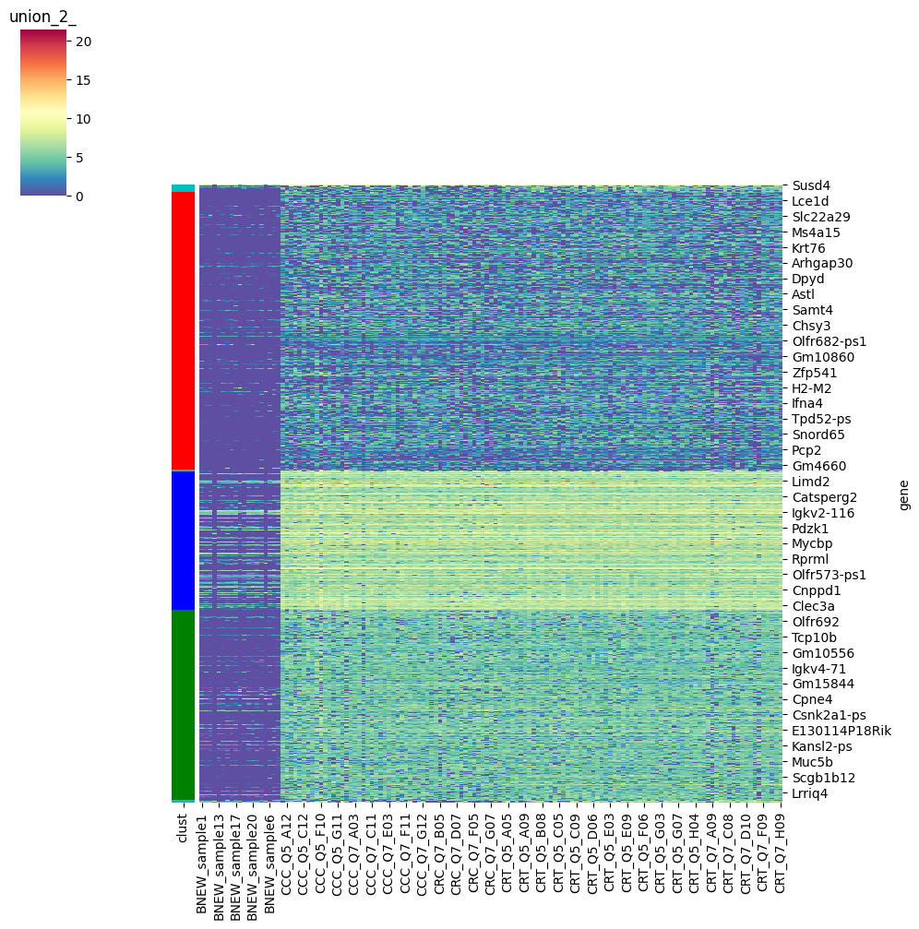

Slide 18
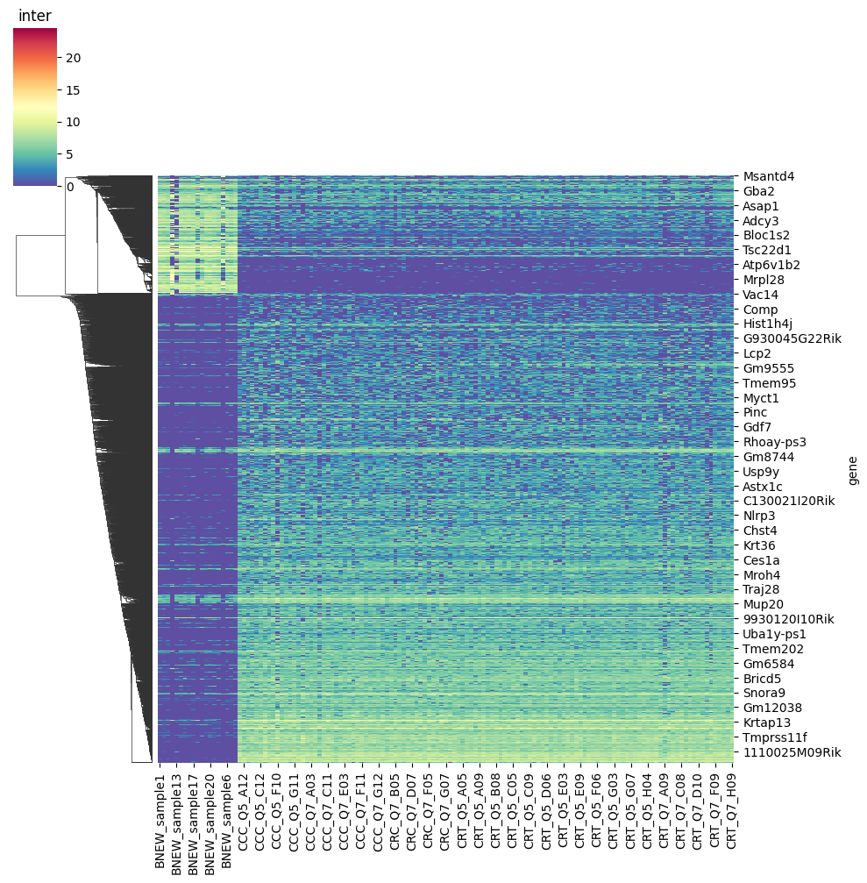
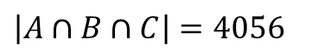
DESeq2 results
A = (LFC>0) $∪$ (LFC<0) in CCC vs NEW
B = (LFC>0) $∪$ (LFC<0) in CRT vs NEW
C = (LFC>0) $∪$ (LFC<0) in CRC vs NEW
A
B
C
$\left|A∩B∩C\right|=4056$

Slide 19
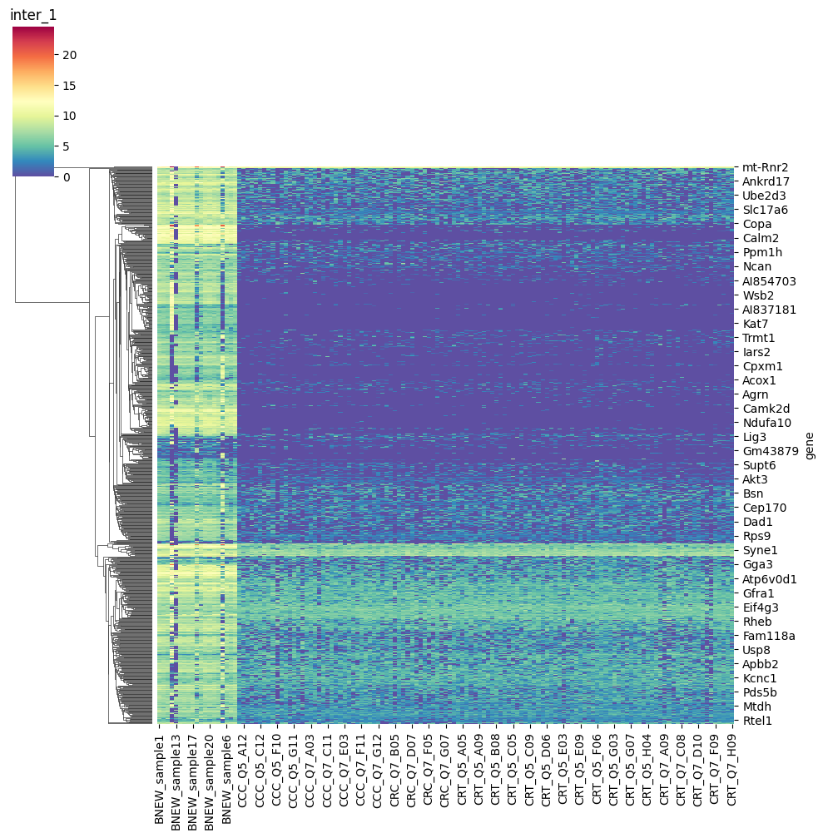
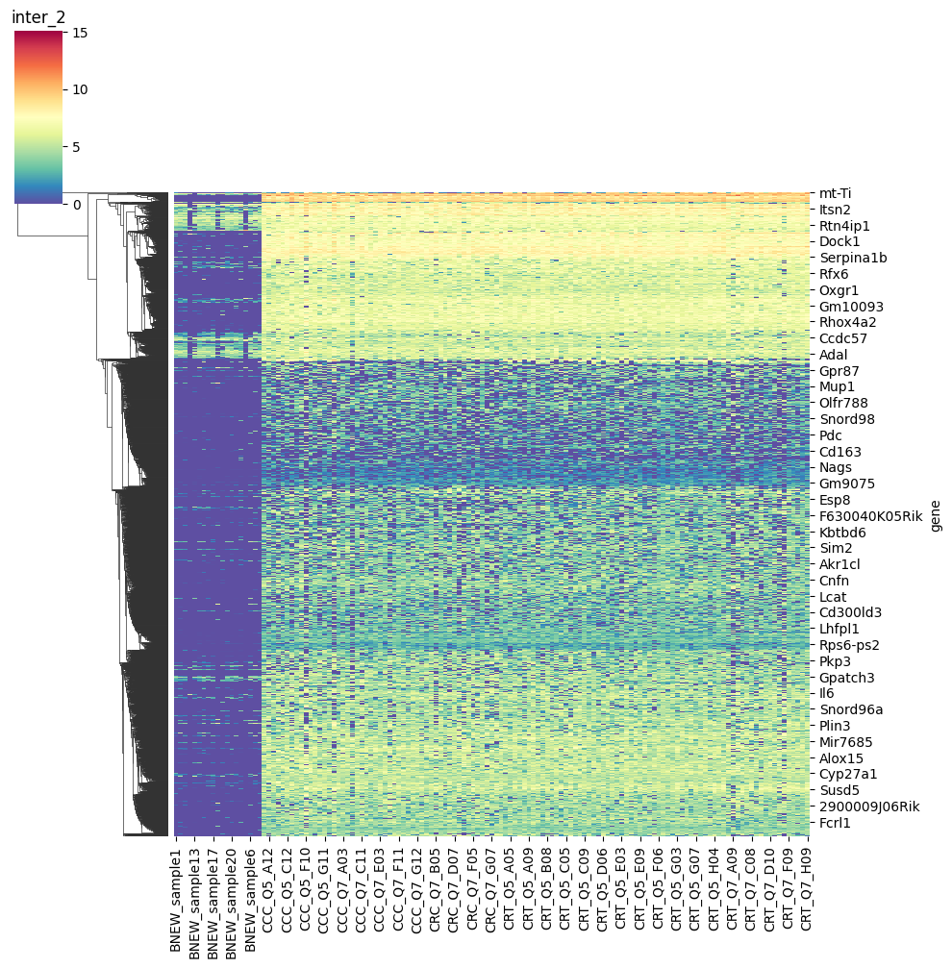

Slide 20
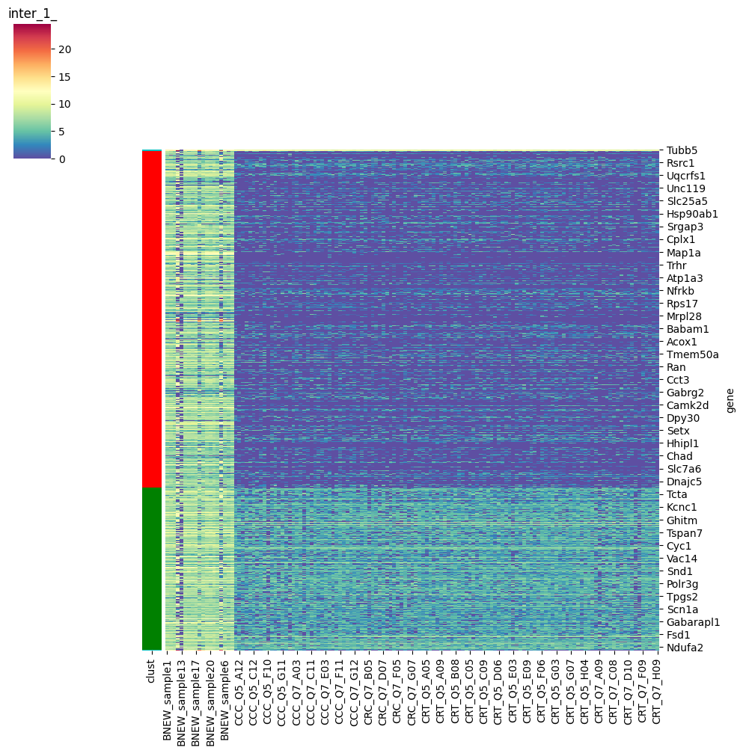

Slide 21
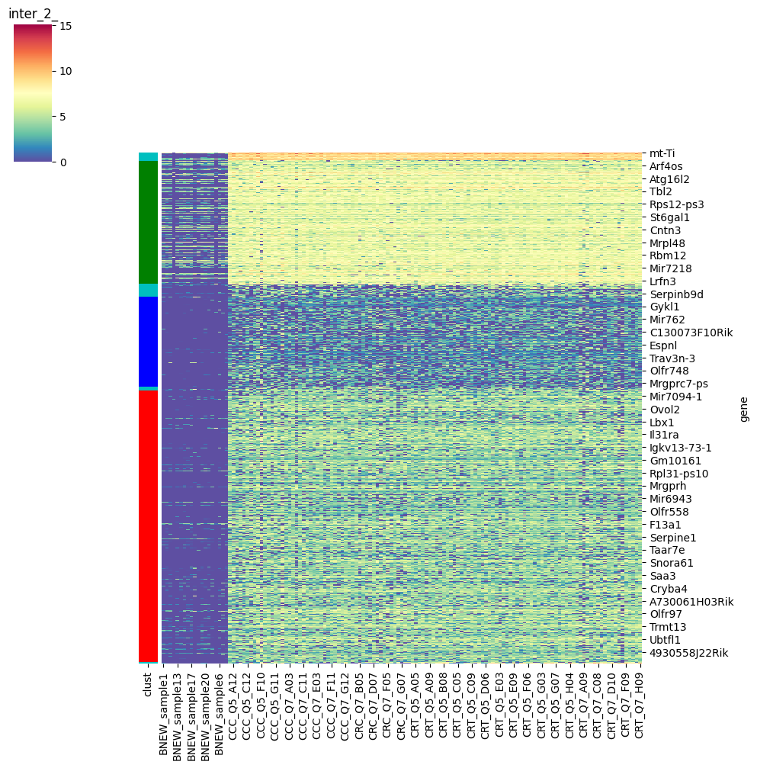

Slide 22
The end

